Slide 1

Conference on Responsible Public Procurement
Barcelona, 22 March 2019

Slide 2
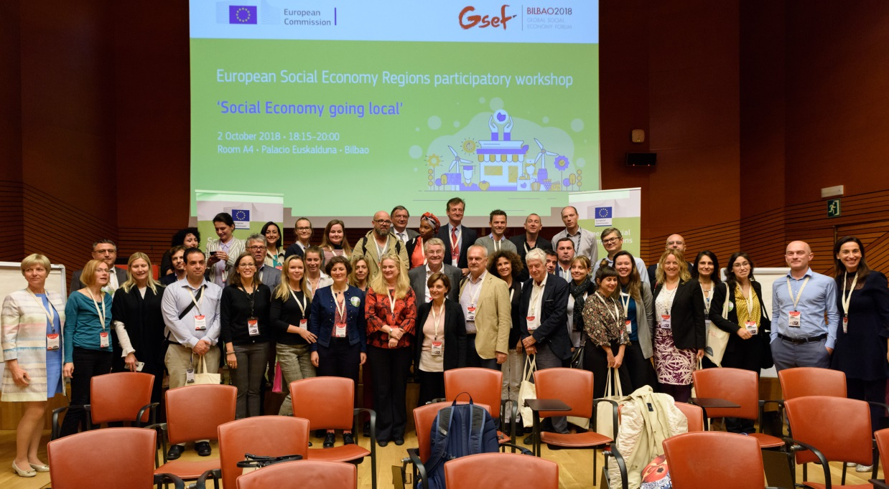

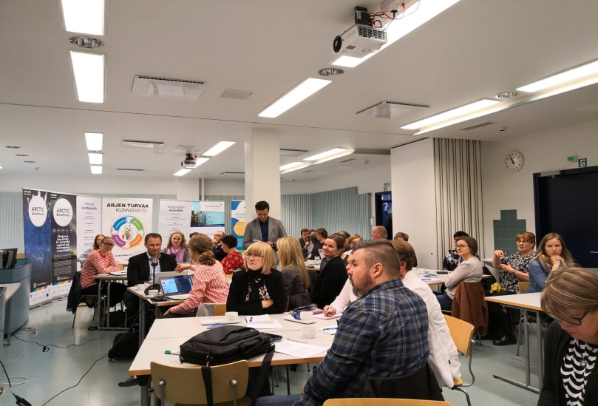
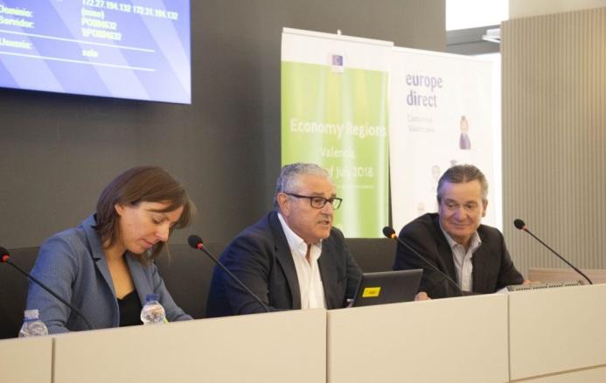
European Social Economy Regions - ESER

Slide 3

Why ESER?
To boost the visibility/recognition of social economy
To better understand of territorial needs
To raise awareness on existing EU support
To set up a European social economy community
► Identify joint challenges and cooperate to find solutions!

Slide 4
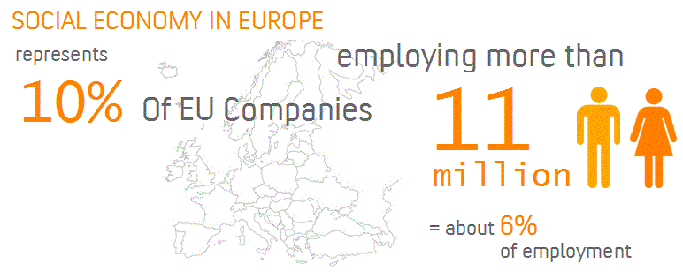
About ESER 2019
55 regions & cities, 20 European countries
A concluding event in Brussels in October with all ESER 2018/2019 regions & cities
Future perspective
European social economy missions
Social Economy Summit - Germany, Nov 2020.

Slide 5

Why promote (socially) responsible public procurement?
Large market (14% of GDP)
Favourable EU legal framework since 2014…
… but very limited uptake and lost opportunities!
► Commission call for strategic use of public procurement

Slide 6
Commission initiatives
Targets = public buyers & social economy stakeholders
Current projects:
Awareness-raising / training events in 15 EU countries (not Spain ☹) – ongoing until end 2019
Update of the Commission ″Buying Social″ guide – publication expected end 2019
Collection of additional good practices and communication campaign – to be launched mid-2019

Slide 7

Thank you!
Follow us on Twitter!
@SocEntEU #EU4SocEnt #ESER2019 #GECES
And join our LinkedIn Community page:
"EU for Social Economy & Social Enterprises"
Website:
https://ec.europa.eu/growth/sectors/social-economy
For more information: Estelle.Bacconnier@ec.europa.eu

